Slide 1
Association Rule Mining (Market Basket Analysis)
Kwagala Ian 2023-B072-20932
Aijuka Josbert 2023-B071-20758
Babirye Stephania 2023-B071-21283
Nakakande Jennifer W.S 2023-B071-22675
Kyoloobi Edwin 2023-B071-22336

Slide 2
Groceries Dataset Analysis
Objective: To analyze grocery transactions to find frequent co-purchase patterns.
Algorithms: Apriori vs. FP-Growth
Dataset: 9,835 transactions from a grocery store.

Slide 3
The Process: From Raw Data to Actionable Insights
Our Workflow
Data Preprocessing: Loaded the data, removed duplicates, and aggregated items into transactions. Cleaned item names for consistency.
Exploratory Data Analysis (EDA): Visualized the most popular items and their co-purchase frequencies to understand the data's landscape.
Model Building: Applied Apriori and FP-Growth algorithms to mine frequent itemsets from the data.
Rule Generation: Generated association rules and ranked them by lift to find the most interesting patterns.
Interpretation: Translated statistical rules into actionable business strategies.

Slide 4
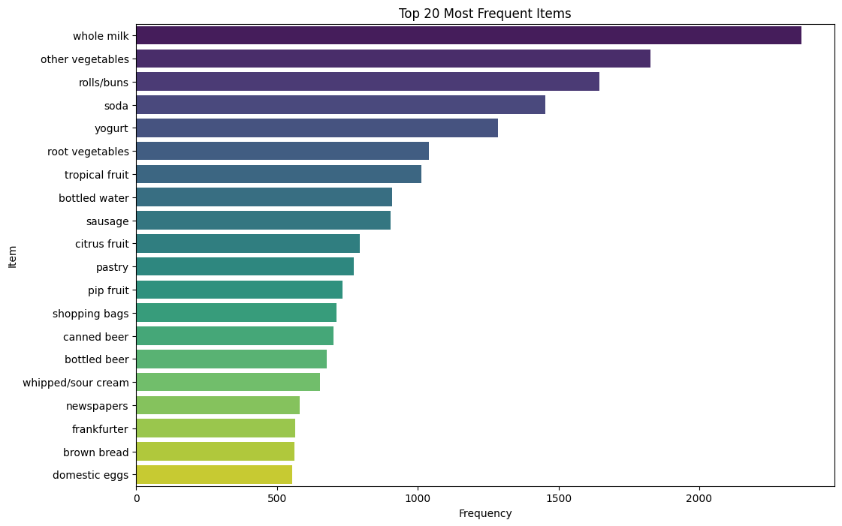
The bar chart of the Top 20 most frequent items

Slide 5
Algorithm Showdown: Apriori vs. FP-Growth Which algorithm is more efficient for our dataset?
Algorithm | How it works | Performance
Apriori | Generates and tests candidate item sets at each level | Slower due to multiple datasets scans
FP-Growth | Uses a compact FP-Tree to mine frequent patterns | Significantly faster; only two database scans.
Conclusion: FP-Growth was the superior choice for this task, offering the same results as Apriori in a fraction of the time.

Slide 6
Our Top 3 Most Powerful Rules Generated Rules with min_support=0.005, min_confidence=0.2, ranked by lift
RULES | SUPPORT | CONFIDENCE | LIFT | BUSINESS INSIGHT
frankfurter → other vegetables | 0.0051 | 0.136 | 1.116 | Meat & Veggie Combo: Frankfurter buyers often add vegetables
bottled beer → whole milk | 0.0072 | 0.158 | 0.999 | Beverage & Dairy Pair: Beer purchases frequently include milk
sausage → whole milk | 0.0090 | 0.148 | 0.940 | Breakfast Bundle: Sausage shoppers commonly buy milk
domestic eggs → whole milk | 0.0053 | 0.142 | 0.901 | Dairy Duo: Egg purchases strongly associate with milk
Key Insight: "Whole milk" is a key connector in many specific purchasing scenarios, not just a popular standalone item.

Slide 7
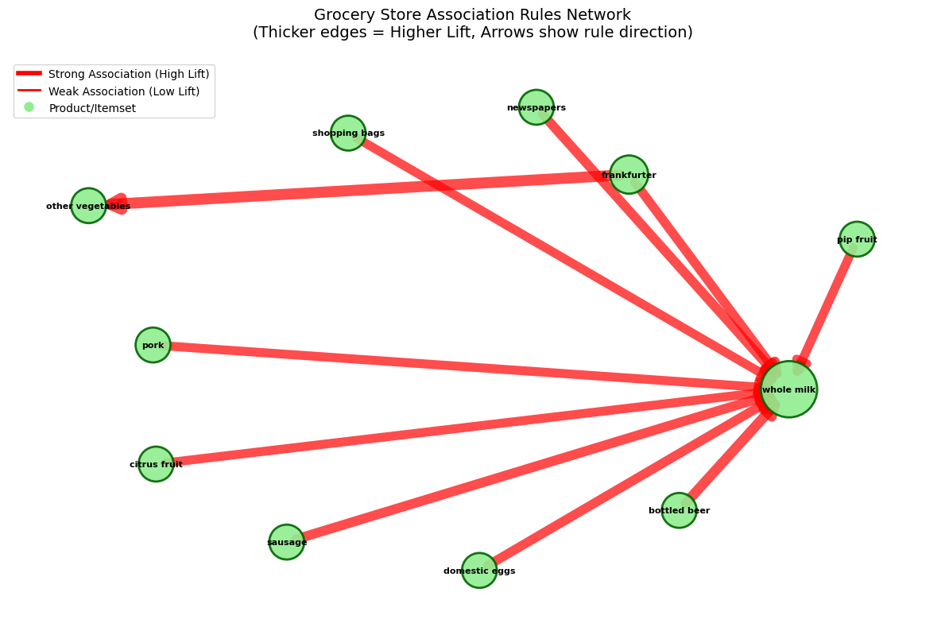
Visualizing The Rules: A Network Graph

Slide 8
Recommendations & Project Reflections
Actionable Strategies
Create "Smart" Bundles: Offer a "Breakfast Smoothie" deal (yogurt + tropical fruit + milk) to boost sales.
Optimize Store Layout: Place high-association items near each other, such as putting a display of tropical fruit near the dairy aisle.
Targeted Promotions: Use checkout data to offer coupons for items a customer is likely to buy but hasn't picked up yet (e.g., offer a milk discount to someone buying rolls and vegetables).
Limitations & Final Thoughts
Support Threshold: Finding the "right" support level is more of an art than a science.
Data Sparsity: Most potential item combinations never appear, making it hard to find patterns.
Future Work: Incorporating customer demographics could unlock even more personalized marketing strategies.

